Slide 1

ReserveRec
Ryan Carrigan, Bryant Conquest, Philip Speegle, Zack Withers
Notes:
Zack

Slide 2
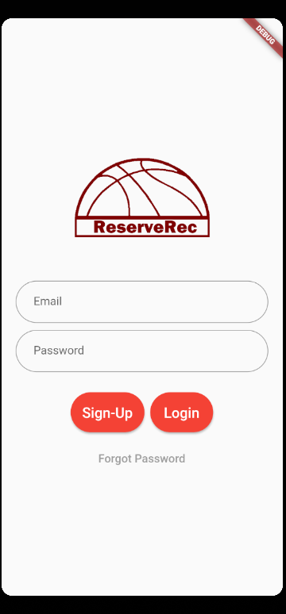
Overview: What is ReserveRec?
Play any sport, any time
Custom feed where you can join or create events
Custom user profiles and display statistics
Notes:
Zack

Slide 3
Major Sprint 2 Goals
Authenticate Users via Firebase
Link Authenticated Users to Firestore and Create Database
Validate User and Location Information
Expand User Profiles
Expand Post Information
Add Dashboard Functionality
Create Unit Tests
4 hours ✓
15 hours ✓
5 hours ✓
10 hours ✓
7 hours ✓
10 hours ✓
2 hours ✓
Overarching Theme: Integration via Firestore and Add Functionality
Notes:
Zack

Slide 4
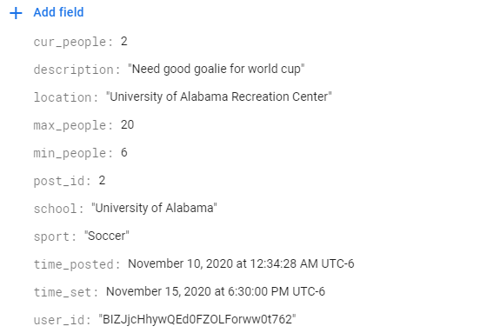
Backend Updates
Authenticate Users via Cloud Firestore
Real-time database updates, additions, retrievals, and deletions
Collections for valid users, posts, emails, and locations
Notes:
Phil

Slide 5
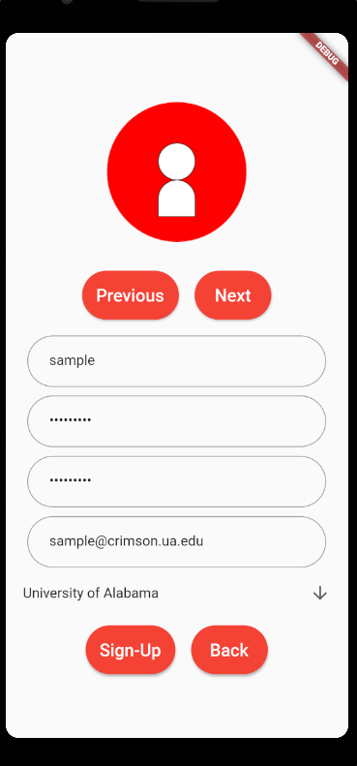
Authentication
Requirements for username and password
Email must be a valid university email
After sign-up, a user must verify their email with a link in order to login
“Forgot password” functionality
All provided through firebase authentication
Notes:
Phil

Slide 6
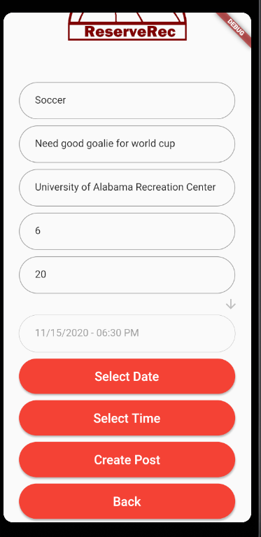
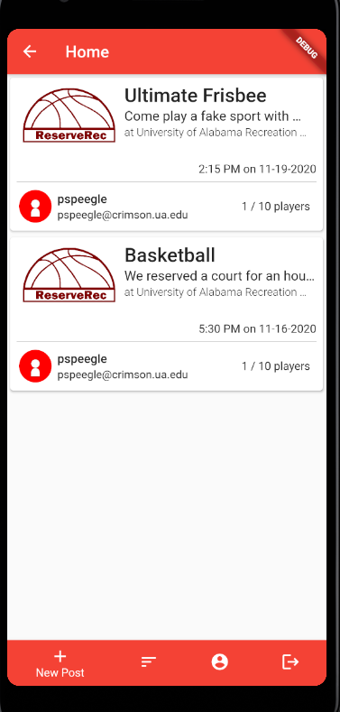
Feed Updates
Sort posts in different ways
DateTime selector for new posts
Nicer layout
Join events others created in real time
Refresh functionality
Notes:
Phil

Slide 7
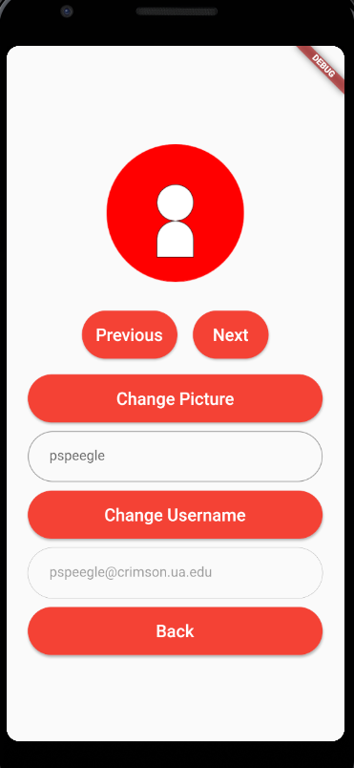
Profile
Separate screen to display user information, change profile picture, and change username
Future Goals: Add “followers/following” to allow filtering of posts
Notes:
Bryant

Slide 8
Challenges
Dart does not have a mature ecosystem
No unit tests with firebase
Lots hidden config things that you don't know until you come across them
Linter Options
Can't use async functionality in a .ForEach
List need to be initialized but it gives no warning
Notes:
Bryant

Slide 9
Future Plans
Create a Manager Profile to be able to create new school and manage posts
Follower Following for your friends
Better feedback from App (snackbar)
Chat for Each Item
Report Players
Statistics
Notes:
Bryant

Slide 10
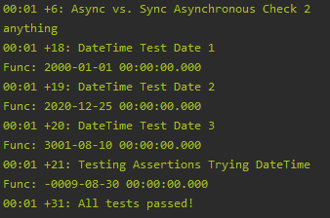
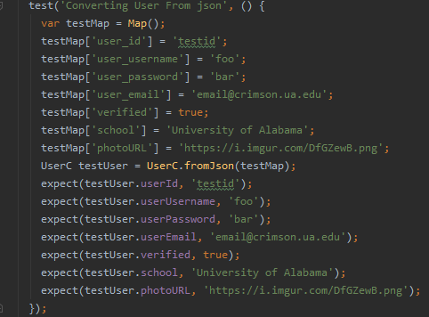
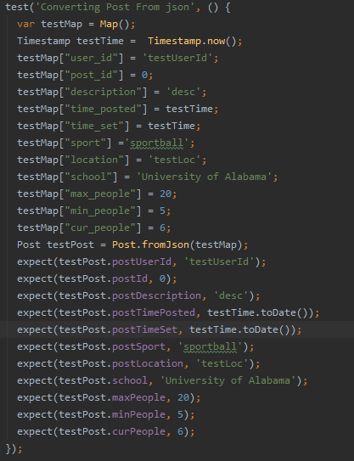
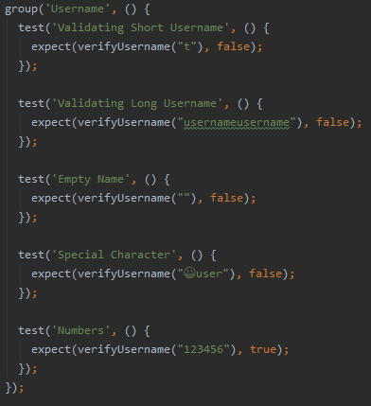
Test Cases

Slide 11
Live Demo

Slide 12
Thank you
Ryan Carrigan: rpcarrigan@crimson.ua.edu
Bryant Conquest: bmconquest@crimson.ua.edu
Philip Speegle: pspeegle@crimson.ua.edu
Zack Withers: wzwithers@crimson.ua.edu

